Slide 1


Fellows Administrative Review
Fall 2014
Fellows Administrative Overview
Fall 2019

Slide 2
Stipends & PeopleSoft
Stipend payments at end of month
PeopleSoft
peoplesoft.harvard.edu
Login with HUID and HarvardKey
Tax forms; direct deposit; view paychecks
Enter emergency contact and other personal information
Contact for financial questions: Sandra Mancebo

Slide 3
Access to building and office
Key and Fob
Elevator Access 9am -5pm to 3R. Fob at other times.
2R & 4R always require fob.
Fob provides 24-hour access.
HUPD 617 495 1212

Slide 4
Harvard Resources
HUID and Harvard Key are necessary for access
Harvard ID:
Campus Service Center
807 Smith Campus Center
1350 Massachusetts Ave
(617) 496-7827
http://www.campusservicecenter.harvard.edu

Slide 5
Computers (Tom and HUIT)
Harvard University Information Technology (HUIT)
Official service provider
5-9000
Hours: Monday - Friday: 7:30AM-8:00PM
Saturday: 10:00AM-6:00PM
Sunday: 12:00PM-5:00PM
HUIT also offers a Walk-in Support Center (Science Center, 1 Oxford Street, Basement-14):
Monday - Friday: 9:00AM-8:00PM
Saturday: 10:00AM-6:00PM
Sunday: 12:00PM-5:00PM
In-House Assistance
Tom Wolejko, Media and Technology Coordinator for the Hutchins Center
Monday – Wednesday: 8:00AM-4:00PM
Room 309, 5-4852
Thursday – Friday: 8:00AM-4:00PM
twolejko@fas.harvard.edu

Slide 6

Health Insurance
Make sure you have adequate coverage. The Harvard International Office maintains a list of providers for foreign scholars. If you are not enlisted in Harvard’s health insurance program, you can still use the Urgent Care facility during working hours. At other times, go to a hospital emergency room. Mt. Auburn Hospital is near, at 330 Mt Auburn St, Cambridge.
Urgent Care
https://huhs.harvard.edu/services/urgent-care
Smith Campus Center, 75 Mt. Auburn St., 3rd Floor

Slide 7
INTERNATIONAL FELLOWS’ REGISTRATION
Register Immediately at the Harvard International Office, 8th floor, Smith Campus Center.
Bring passport and visa documents
To use elevator, show appointment letter or an ID (such as passport) and inform guard of destination.
Notes:
REGISTER WITH INT’L OFFICE
SOCIAL SECURITY NUMBER – ALL BEING PAID IN U.S. should have SS#
- don’t have to be a perm resident/citizen

Slide 8
University Closings
See
https://registrar.fas.harvard.edu/ten-year-calendar
Upcoming Holidays
    October 14, Columbus Days; Hutchins closed
November 11, Veterans’ Day; Hutchins closed
November 28-29, Thanksgiving; Hutchins closed
Hutchins sometimes will be closed when Harvard University is open. Harvard occasionally closes in bad weather.

Slide 9
NUTS AND BOLTS (Velma)
  Fill out Front Office Registration form in Welcome Folder
  Phones; Voicemail instructions
  Email Addresses: Give both Velma and Krishna your preferred email addresses (Harvard or other)
  Photocopy Machine and fax
  Supplies
  Mailbox
  Note: We cannot forward packages after the end of your residency. We also expect the offices to be vacated and clean by the last date of your residency

Slide 10
MEETING SPACE
2nd Floor, Hutchins Seminar
To Reserve Meeting Space:
Contact Velma at velmadupont@fas.harvard.edu

Slide 11
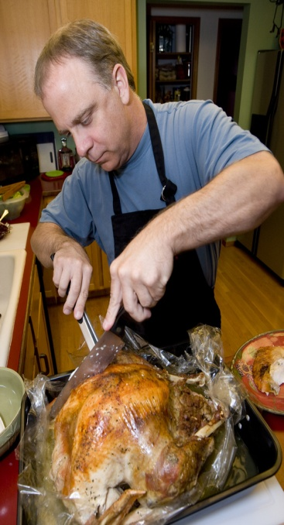
KITCHEN & RECYCLING
Communal Kitchen
Tea and Coffee
Water
Refrigerator
Recycling
Notes:
Communal kitchen 3rd and 4th floors
Tea, Coffee ,Cocoa, and Milk available
Water
Refrigerator - cleaning
Please keep the area clean
WE RECYCLE

Slide 12

EMERGENCY EVACUATION
In an emergency, you must evacuate the building
Meeting place is Winthrop Park, near Peet’s
Velma will instruct on emergency exit procedure after this meeting

Slide 13
POLICIES
Copyrights
Copying or sending copyrighted software or materials via email is
strictly forbidden by HU.
Use of Harvard Name and Insignia
See HU Policy (also available in Fellows guide)
https://trademark.harvard.edu/policy-on-use-of-harvard-names-and-insignias
Using Letterhead
Use for professional correspondence
Do not use for non-Institute/Research business
or commercial endorsement

Slide 14

Art Tour with
Senior Curatorial
Associate Sheldon
Cheek
Every Friday
at 1 pm. Meet at the Reception Area, 3R.

Slide 15
Events
Fellows’ Attendance Required at:
Colloquium Series (nearly every Wednesday at noon, Thompson Room, Barker Center, 12 Quincy Street). If you miss a colloquium, please let the fellow know in advance, and provide feedback by either watching the recording of the colloquium or reading the paper itself.
Welcome Lunch hosted by Prof. Gates
Fellows Workshops (Dates for this semester are already on calendar)

Slide 16
Other Upcoming Events
We have a robust, full calendar, with the Major Lectures Series as a primary focus. We encourage you to attend as many events as you can.

Slide 17
Across campus
We work closely with the Center for African Studies (note
African Studies Workshops) and the
Warren Center for Studies in American History (its
lecture series)
Other strong lecture series and programs include the Mahindra Humanities Center, The Davis Center for Russian and Eurasian Studies, Southasia Institute, Center for Middle East Studies, the Prince Alwaleed Bin Talal Islamic Studies Program, Graduate School of Education (Askwith Forum), Kennedy Center for Public Leadership (Sheila Johnson Fellows), Nieman Foundation, Radcliffe, the Weatherhead Center, (including The Harvard Academy for International and Area Studies), the Fairbanks Center, the Design School, Berkman Center for Internet and Society, and the Institute for Quantitative Social Science.

Slide 18
Other Resources
  Library Liaison Sue Gilroy and specialists at Widener Library
  http://hutchinscenter.fas.harvard.edu/academic-resources
  Fellows Facebook https://www.facebook.com/HutchinsDuBoisFellows
  Fellows Twitter
  @DuBoisResFellow
  Send us your Twitter and Facebook information!

Slide 19
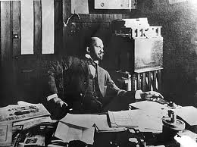
And finally: We hope your time with us is productive, fun, and memorable!

